Slide 1
Android Security Essentials
Pragati Ogal Rai
Mobile Technology Evangelist
X.commerce (an eBay Inc. Company)

Slide 2
Agenda
Why should I understand Android’s Security Model?
Android platform security model
Android application security model
Android device security

Slide 3
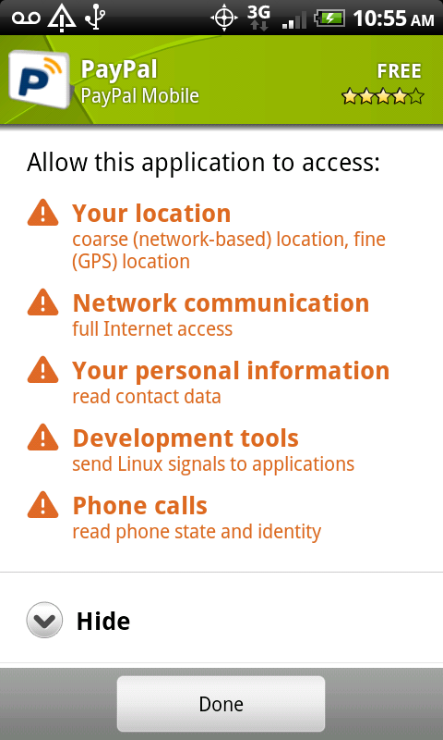
Why should I understand Android’s Security Model?
Smart(er) Phones
Open Platform
Variety of devices
YOU control your phone

Slide 4
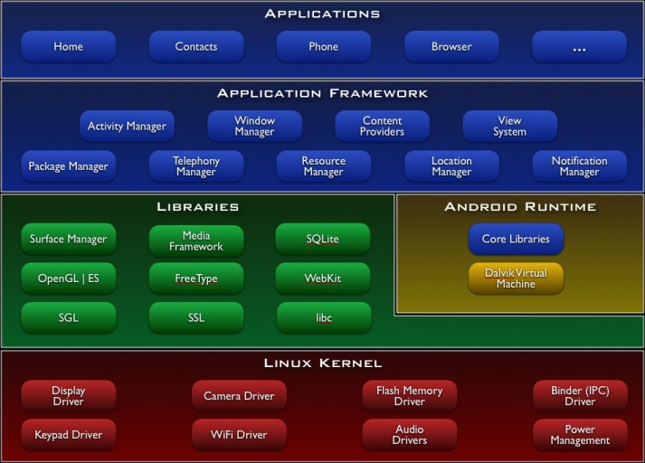
Android OS Architecture
http://developer.android.com/guide/basics/what-is-android.html

Slide 5
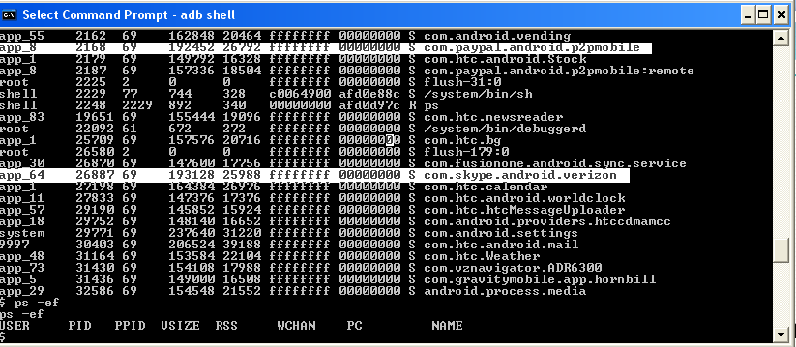
Linux Kernel
Distinct UID and GID for each application at install time
Sharing can occur through component interactions
Linux process sandbox

Slide 6
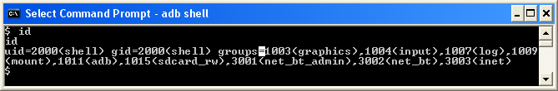
Linux Kernel (Cont’d)
include/linux/android_aid.h
AID_NET_BT 3002 Can create Bluetooth Sockets
AID_INET 3003 Can create IPv4 and IPv6 Sockets

Slide 7
Middleware
Dalvik VM is not a security boundary
No security manager
Permissions are enforced in OS and not in VM
Bytecode verification for optimization
Native vs. Java code

Slide 8
Application Layer
Permissions restrict component interaction
Permission labels defined in AndroidManifest.xml
MAC enforced by Reference Monitor
PackageManager and ActivityManager enforce permissions

Slide 9
Permission Protection Levels
Normal
  android.permission.VIBRATE
  com.android.alarm.permission.SET_ALARM
Dangerous
  android.permission.SEND_SMS
  android.permission.CALL_PHONE
Signature
  android.permission.FORCE_STOP_PACKAGES
  android.permission.INJECT_EVENTS
SignatureOrSystem
  android.permission.ACCESS_USB
  android.permission.SET_TIME

Slide 10
User Defined Permissions
Developers can define own permissions
  <permission android:name="com.pragati.permission.ACCESS_DETAILS"
  android:label="@string/permlab_accessDetails"
  android:description="@string/permdesc_accessDetails"
  android:permissionGroup="android.permission-group.COST_MONEY"
  android:protectionLevel=“signature" />

Slide 11
Components
Activity: Define screens
Service: Background processing
Broadcast Receiver: Mailbox for messages from other applications
Content Provider: Relational database for sharing information
Instrumentation: Testing
All components are secured with permissions

Slide 12
Binder
Synchronous RPC mechanism
Define interface with AIDL
Same process or different processes
transact() and Binder.onTransact()
Data sent as a Parcel
Secured by caller permission or identity checking

Slide 13
Intents
Inter Component Interaction
Asynchronous IPC
Explicit or implicit intents
Do not put sensitive data in intents
Components need not be in same application
  startActivity(Intent), startBroadcast(Intent)

Slide 14
Intent Filters
Activity Manager matches intents against Intent Filters
  <receiver android:name=“BootCompletedReceiver”>
    <intent-filter>
      <action android:name=“android.intent.action.BOOT_COMPLETED”/>
    </intent-filter>
  </receiver>
Activity with Intent Filter enabled becomes “exported”
Activity with “android:exported=true” can be started with any intent
Intent Filters cannot be secured with permissions
Add categories to restrict what intent can be called through
  android.intent.category.BROWSEABLE

Slide 15
Pending Intent
Token given to a foreign application to perform an action on your application’s behalf
Use your application’s permissions
Even if its owning application's process is killed, PendingIntent itself will remain usable from other processes
Provide component name in base intent
  PendingIntent.getActivity(Context, int, Intent, int)

Slide 16
AndroidManifest.xml
Application Components
Rules for auto-resolution
Permissions
Access rules
Runtime dependencies
Runtime libraries

Slide 17
Application Signature
Applications are self-signed; no CA required
Signature define persistence
  Detect if the application has changed
  Application update
Signatures define authorship
  Establish trust between applications
  Run in same Linux ID

Slide 18
Application Upgrade
Applications can register for auto-updates
Applications should have the same signature
No additional permissions should be added
Install location is preserved

Slide 19
System Packages
Come bundled with ROM
Have signatureOrSystem Permission
Cannot be uninstalled
/system/app

Slide 20
External Storage
Starting API 8 (Android 2.2) APKs can be stored on external devices
  APK is stored in encrypted container called asec file
  Key is randomly generated and stored on device
  Dex files, private data, native shared libraries still reside on internal memory
  External devices are mounted with “noexec”
VFAT does not support Linux access control
Sensitive data should be encrypted before storing

Slide 21
Device Security Features
No Default Access to Device Metadata
Extensible DRM Framework
External Storage (Android 2.2)
No Third Party SIM Card Access
Protected access to cost generating APIs
Full File System Encryption (Android 3.0)
Password Protection
Remote Device Administration (Android 2.2)
Memory Management Features

Slide 22
Summary
Linux process sandbox
Permission based component interaction
Permission labels defined in AndroidManifest.xml
Applications need to be signed
Signature define persistence and authorship
Install time security decisions

Slide 23
Thank you!
pragati@x.com
@pragatiogal
http://www.slideshare.net/pragatiogal

